Slide 1
The Importance of Technology in High School Science
Amy Roediger

Slide 2
Let’s Get Up and Atom!
Think about a traditional unit on atomic structure.
What are some
reasons students
would not enjoy learning this content?

Slide 3
Extreme Science Lesson Makeover
Ohio’s Quality Review Rubric is a tool for educators to use to self-evaluate the degree to which they are tailoring lessons to the Ohio New Learning Standards.

Slide 4
Extreme Science Lesson Makeover
Let’s use the Quality Review Rubric
and to give our traditional treatment of atomic structure and extreme makeover.

Slide 5
Alignment to Ohio NLS
Aligns with the main concept and the specific descriptions within Ohio’s NLS.*
Selects scientifically accurate materials and resources that measures grade-level appropriate content and practices.*

Slide 6
Alignment to Ohio NLS
Content is relevant to students, significant from a global perspective and requires students to communicate to an external audience.
Notes:
Alignment to Ohio NLS
Content is relevant to students, significant from a global perspective and requires students to communicate (data, findings and research) to an external audience.

Slide 7
Alignment to Ohio NLS
Integrates reading, writing, speaking and listening so that students apply and synthesize advancing literacy skills.*

Slide 8
Alignment to Ohio NLS
Texts that build content knowledge, support scientific practices, infuse reading and writing, and encourage interdisciplinary connections.
Incorporates technology and scientific practices to solve or evaluate engineering or technological problems.

Slide 9
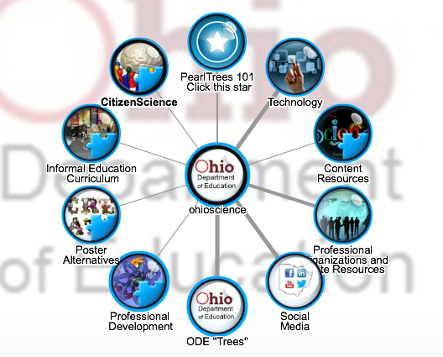
How Can Technology Help?
Try some of these resources!

Slide 10
Key Areas of Focus
Scientific Practices: Instruction designed to build scientific knowledge and practices through student-led investigation must be provided.

Slide 11
Key Areas of Focus
Testable research questions are generated and used to design procedures and conduct investigations.
Results and findings are formally communicated, critiqued and defended.
Opportunities for student reflection are provided.*

Slide 12
Key Areas of Focus
Reading Scientific Texts Closely: Reading scientific literature, including research investigations, is a central focus of instruction.
Increasing Text Complexity: Focuses students on reading a progression of complex, sequenced, scaffolded scientific materials drawn from the grade-level band.*

Slide 13
Key Areas of Focus
Research-Based Evidence: Facilitates rich and rigorous evidence-based discussions and writing about common scientific resources through a sequence of specific, thought-provoking, and text-dependent questions.*

Slide 14
Key Areas of Focus
Writing from Sources: Students draw evidence from scientific literature including research investigations to produce clear and coherent writing that informs, explains, or makes an argument in various written forms.

Slide 15
Key Areas of Focus
Academic Vocabulary: Builds students’ scientific vocabulary for concepts and phenomena that have first been explored through scientific investigation.*

Slide 16
Key Areas of Focus
Building Disciplinary Knowledge: Students to build knowledge about a topic or subject through analysis of a coherent selection of strategically sequenced, scientific literature including research investigations.

Slide 17
Key Areas of Focus
Balance of Writing: Includes a balance of on-demand and process writing (e.g. multiple drafts and revisions over time) and short, focused research projects, incorporating virtual resources or materials where appropriate.*

Slide 18
Key Areas of Focus
Incorporation of Technology: Uses appropriate technology and media strategically and ethically to deepen learning and draw attention to scientific evidence.*

Slide 19
How Can Technology Help?
Try some of these resources!

Slide 20
Instructional Supports
Use previous student data to design instruction.*
Cultivates student interest and engagement in reading, writing, and speaking about science.
Defines clear learning targets that build content knowledge using Science’s Cognitive Demands.*

Slide 21
Instructional Supports
Provides all students with multiple, differentiated opportunities to engage with materials/resources/ investigations/text that are grade-level appropriate.*
Integrates appropriate supports and extensions including but not limited to reading, writing, listening and speaking for students who are ELL, have disabilities, or read well below or above the grade level.*

Slide 22
Instructional Supports
Cultivates student interest and engagement in reading, writing, and speaking about texts.**
Addresses instructional expectations and is easy to understand and use.

Slide 23
Instructional Supports
Provides all students with multiple, differentiated opportunities to engage with text of appropriate complexity for the grade level; includes appropriate scaffolding so that students directly experience the complexity of the text.**

Slide 24
Instructional Supports
Focuses on challenging sections of the text(s) and engages students in a productive struggle through discussion questions and other supports that build toward independence.

Slide 25
Instructional Supports
Focuses on challenging text, resources and investigations, engaging students in a productive struggle to build toward independence.
Promotes responses which cite evidence to demonstrate deeper understanding of the content*

Slide 26
Instructional Supports
Includes a progression of learning where concepts and practices advance and deepen over time.

Slide 27
Instructional Supports
Provides for authentic learning, application of literacy skills, student-directed inquiry, analysis, evaluation, and/or reflection.
Encourages independent reading based on student choice and interest in science.

Slide 28
How Can Technology Help?
Try some of these resources!

Slide 29
Assessment
Elicits direct, observable evidence of the degree to which a student can independently demonstrate the major targeted grade level Science standards and Cognitive Demands.*

Slide 30
Assessment
Assesses student proficiency using methods that are unbiased and accessible to all students.

Slide 31
Assessment
Includes aligned rubrics or assessment guidelines that provide sufficient guidance for interpreting student performance.*
Uses varied modes of assessment, including a range of pre, formative, summative, and student self- assessment

Slide 32
How Can Technology Help?
Try some of these resources!

Slide 33
education.ohio.gov

Slide 34
Social Media
Ohio Families and Education
Ohio Teachers’ Homeroom
ohio-department-of-education
storify.com/ohioEdDept
@OHEducation
OhioEdDept

